Slide 1
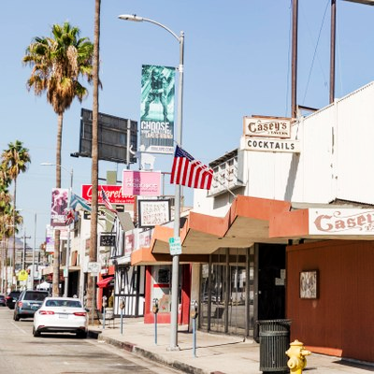
Canoga Park
Business Improvement District
An economic analysis of the COVID-19 Pandemic
Notes:
Chloe 25 min

Slide 2
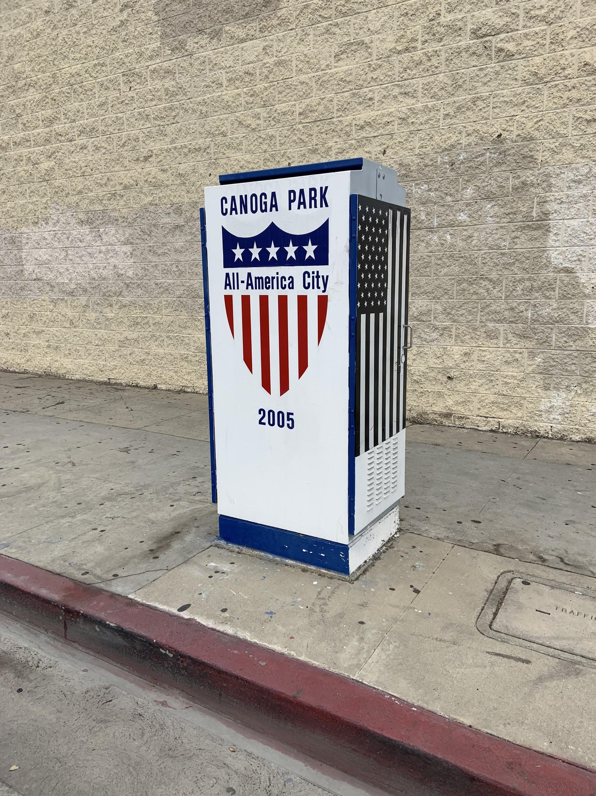
1.
Background of Canoga Park BID
Notes:
Chloe

Slide 3
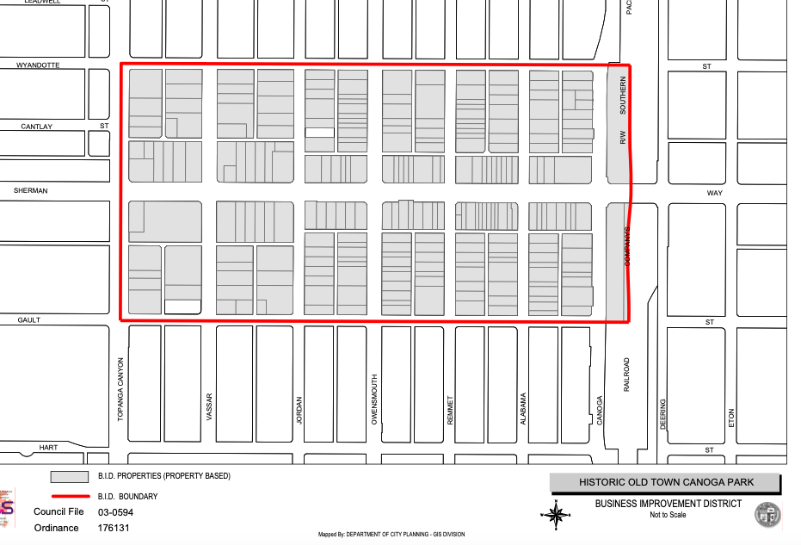
Parameters of the Canoga Park Business Improvement District
Wyandotte St to Gault St
Glade Ave to Canoga Ave

Slide 4
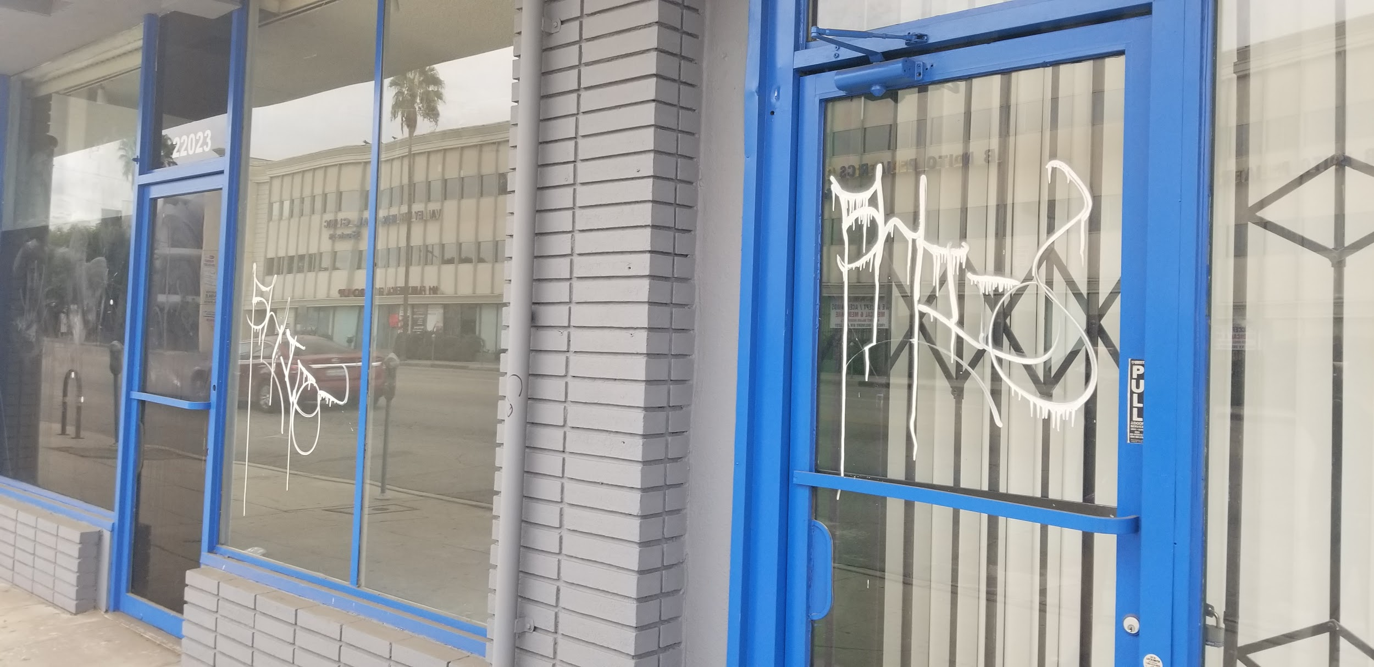
Purposes of Business Improvement Districts
Provides additional services outside of City provided services
Potential services:
Trash collection
Sidewalk Pick-up
Tree maintenance
Advertising
Advocacy
Security
Graffiti removal

Slide 5
BID Creation & Financial Structure
Creation
Requires over 50% support from property owners
BID present in west Canoga Park vs. no BID on east side
Financial Structure
Services funded through property assessments
Based on square footage
Property tax payments
Budget roughly $230,000

Slide 6
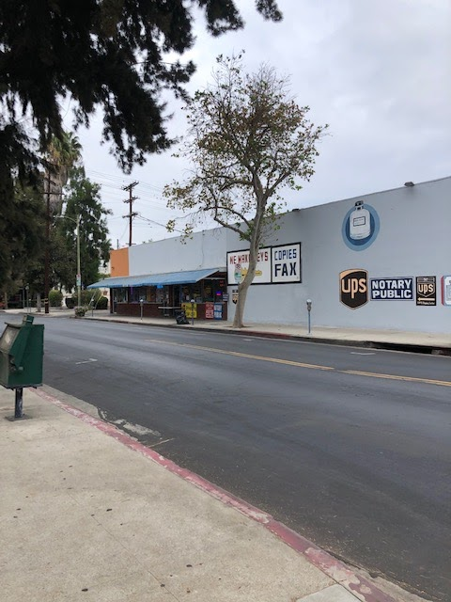
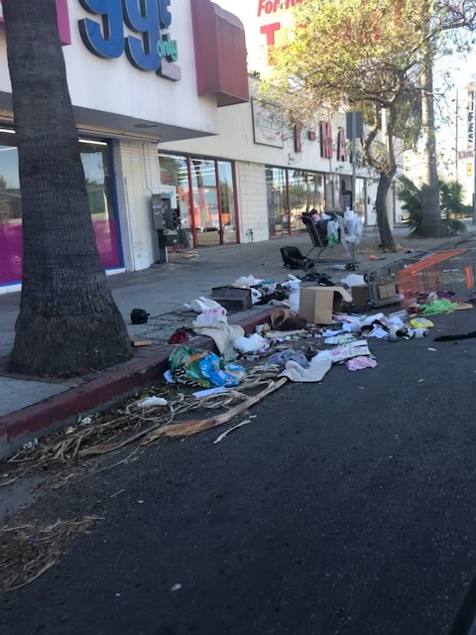
Beautification Comparison:
East & West Side Canoga Park
West Side with BID
East Side without BID

Slide 7
2.
COVID-19 Pandemic
Notes:
Susie

Slide 8
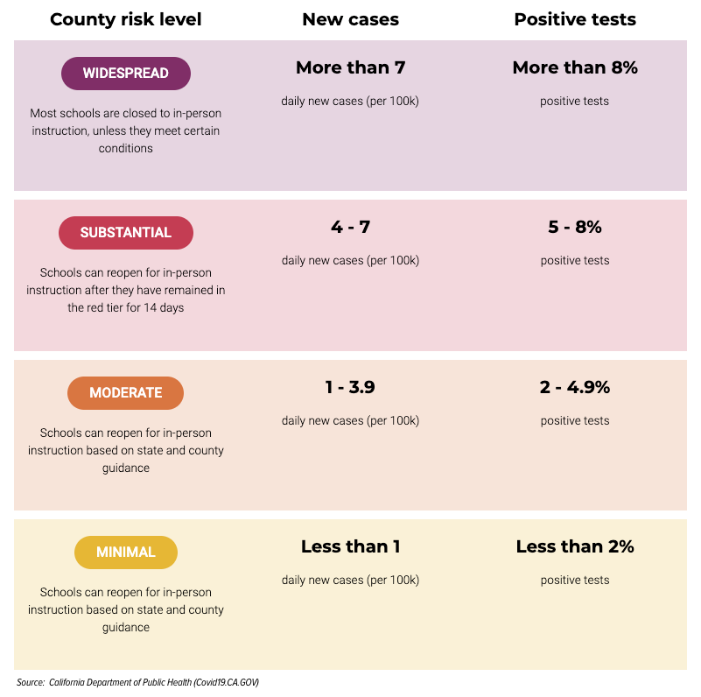
Federal & State Responses to COVID-19 Pandemic
March 19 2020: Stay at Home Order
Temporary closures outside essential businesses
Pandemic Roadmap for CA
1. Safety & Preparation
2. Reopening Lower-Risk Workplaces
3. Reopening Higher-Risk Workplaces
4. Easing of Final Restrictions
2nd phase May 2020
Blueprint for a Safer Economy
Outlined activity restrictions
Notes:
Blueprint is the tiers, purple

Slide 9
LA County Restrictions
Regulations vary by county
Assigned tier based on case numbers & positivity rates
L.A. County “widespread” rating
Most restrictive tier
8% positivity & more than 7 new cases per 100,000 weekly
“Widespread” tier restrictions
Some businesses must remain closed
Ex. Movie theaters, amusement parks, bars (without food)
Some operate with modifications & capacity limits
Ex auto repair, banks
Ex restaurants (outdoors with modifications or take-out)

Slide 10
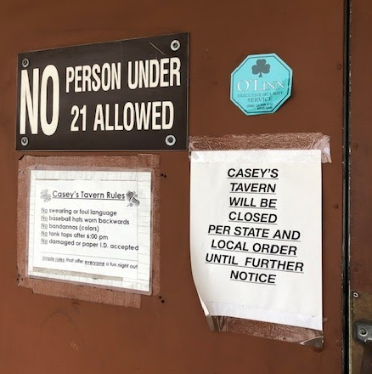
Fiscal Impact of Pandemic
CARES ACT
Small business support: 280 billion
Businesses filing bankruptcy in L.A. County Rose Sharply
City of L.A. potential budget shortfall of $600 million (2020-2021)
Vulnerable industries
Restaurants
Retail industry & Specialty Shops
Entertainment
Hospitality
Numerous businesses closed temporarily on Sherman Way

Slide 11
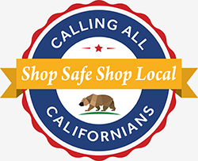
Small Business Assistance Programs
Federal:
Small Business Administration (SBA)
Paycheck Protection Program
Economic Injury Disaster Loan SBA Express Bridge Loans
SBA Debt Relief
State of California :
IBank
Small Business Disaster Relief Loan Guarantee Program
CA Capital Access Program

Slide 12
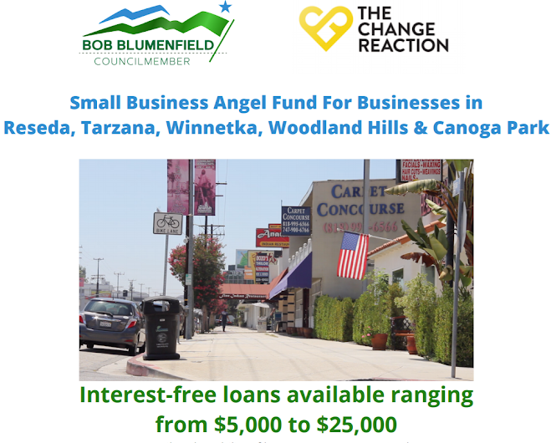
Small Business Assistance Programs
Los Angeles County/City:
L.A. Regional Recovery Fund
L.A. County Employer Assistance Grant
L.A. County Small Business Revitalization Grant Program
L.A. City Small Business Emergency Microloan Program
District Level:
Small Business Angel Fund

Slide 13
3.
Proposed Changes: Economic Analysis of Sherman Way Businesses
Notes:
Alex

Slide 14
Economic Analysis Strategy
Parameters: “Historic Downtown” along Sherman Way
Glade Ave to Canoga Ave
Roughly 130 businesses
Goals:
1. Quantify closures and vacancies
2. Assess loss in sales tax revenue from vacancies
3. Gather current needs of business owners

Slide 15
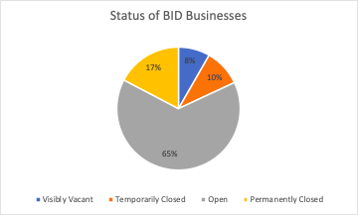
Overview of Pandemic Businesses
Sample of 130 Businesses, data for 113
Closed: 36
Visibly vacant: 11
Temporarily Closed: 13
Limited information on vacancies pre-COVID
Open: 86
Businesses that said that they had to close for a few months: 6
Prior to pandemic 5-6 vacancies
Vacancies & illegal businesses
Tax revenue: $ 870,836 - $ 1,800,052
Notes:
Sampled in October/November

Slide 16
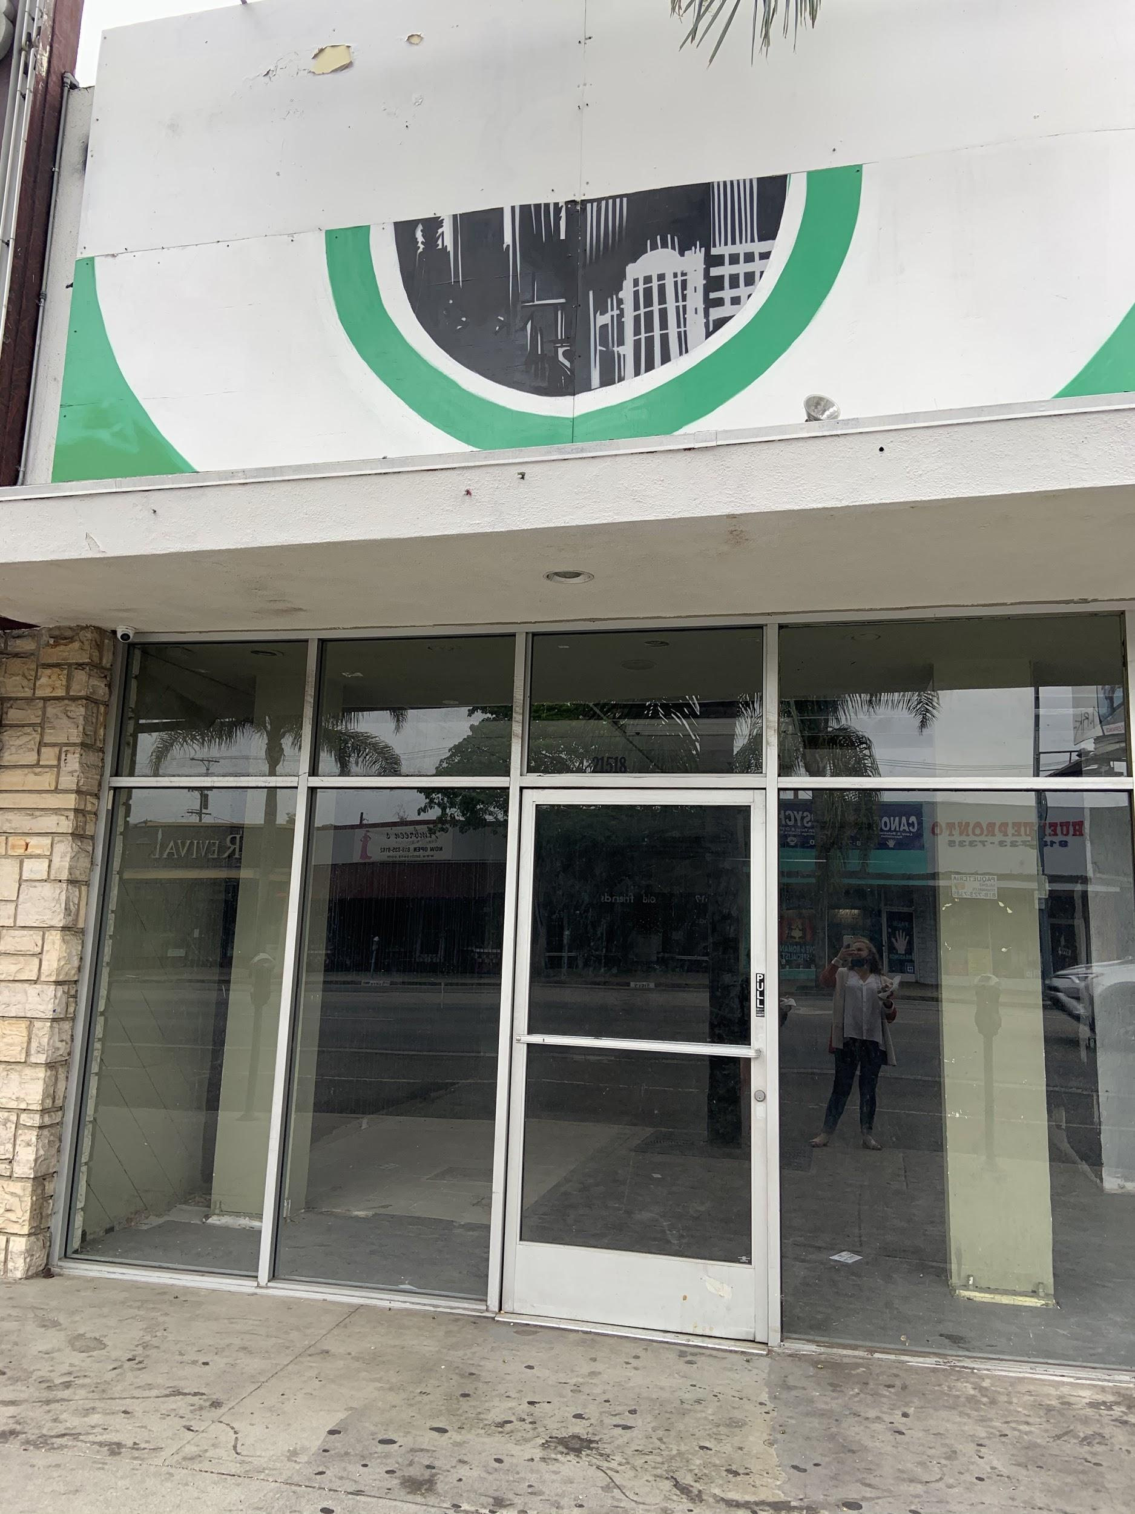
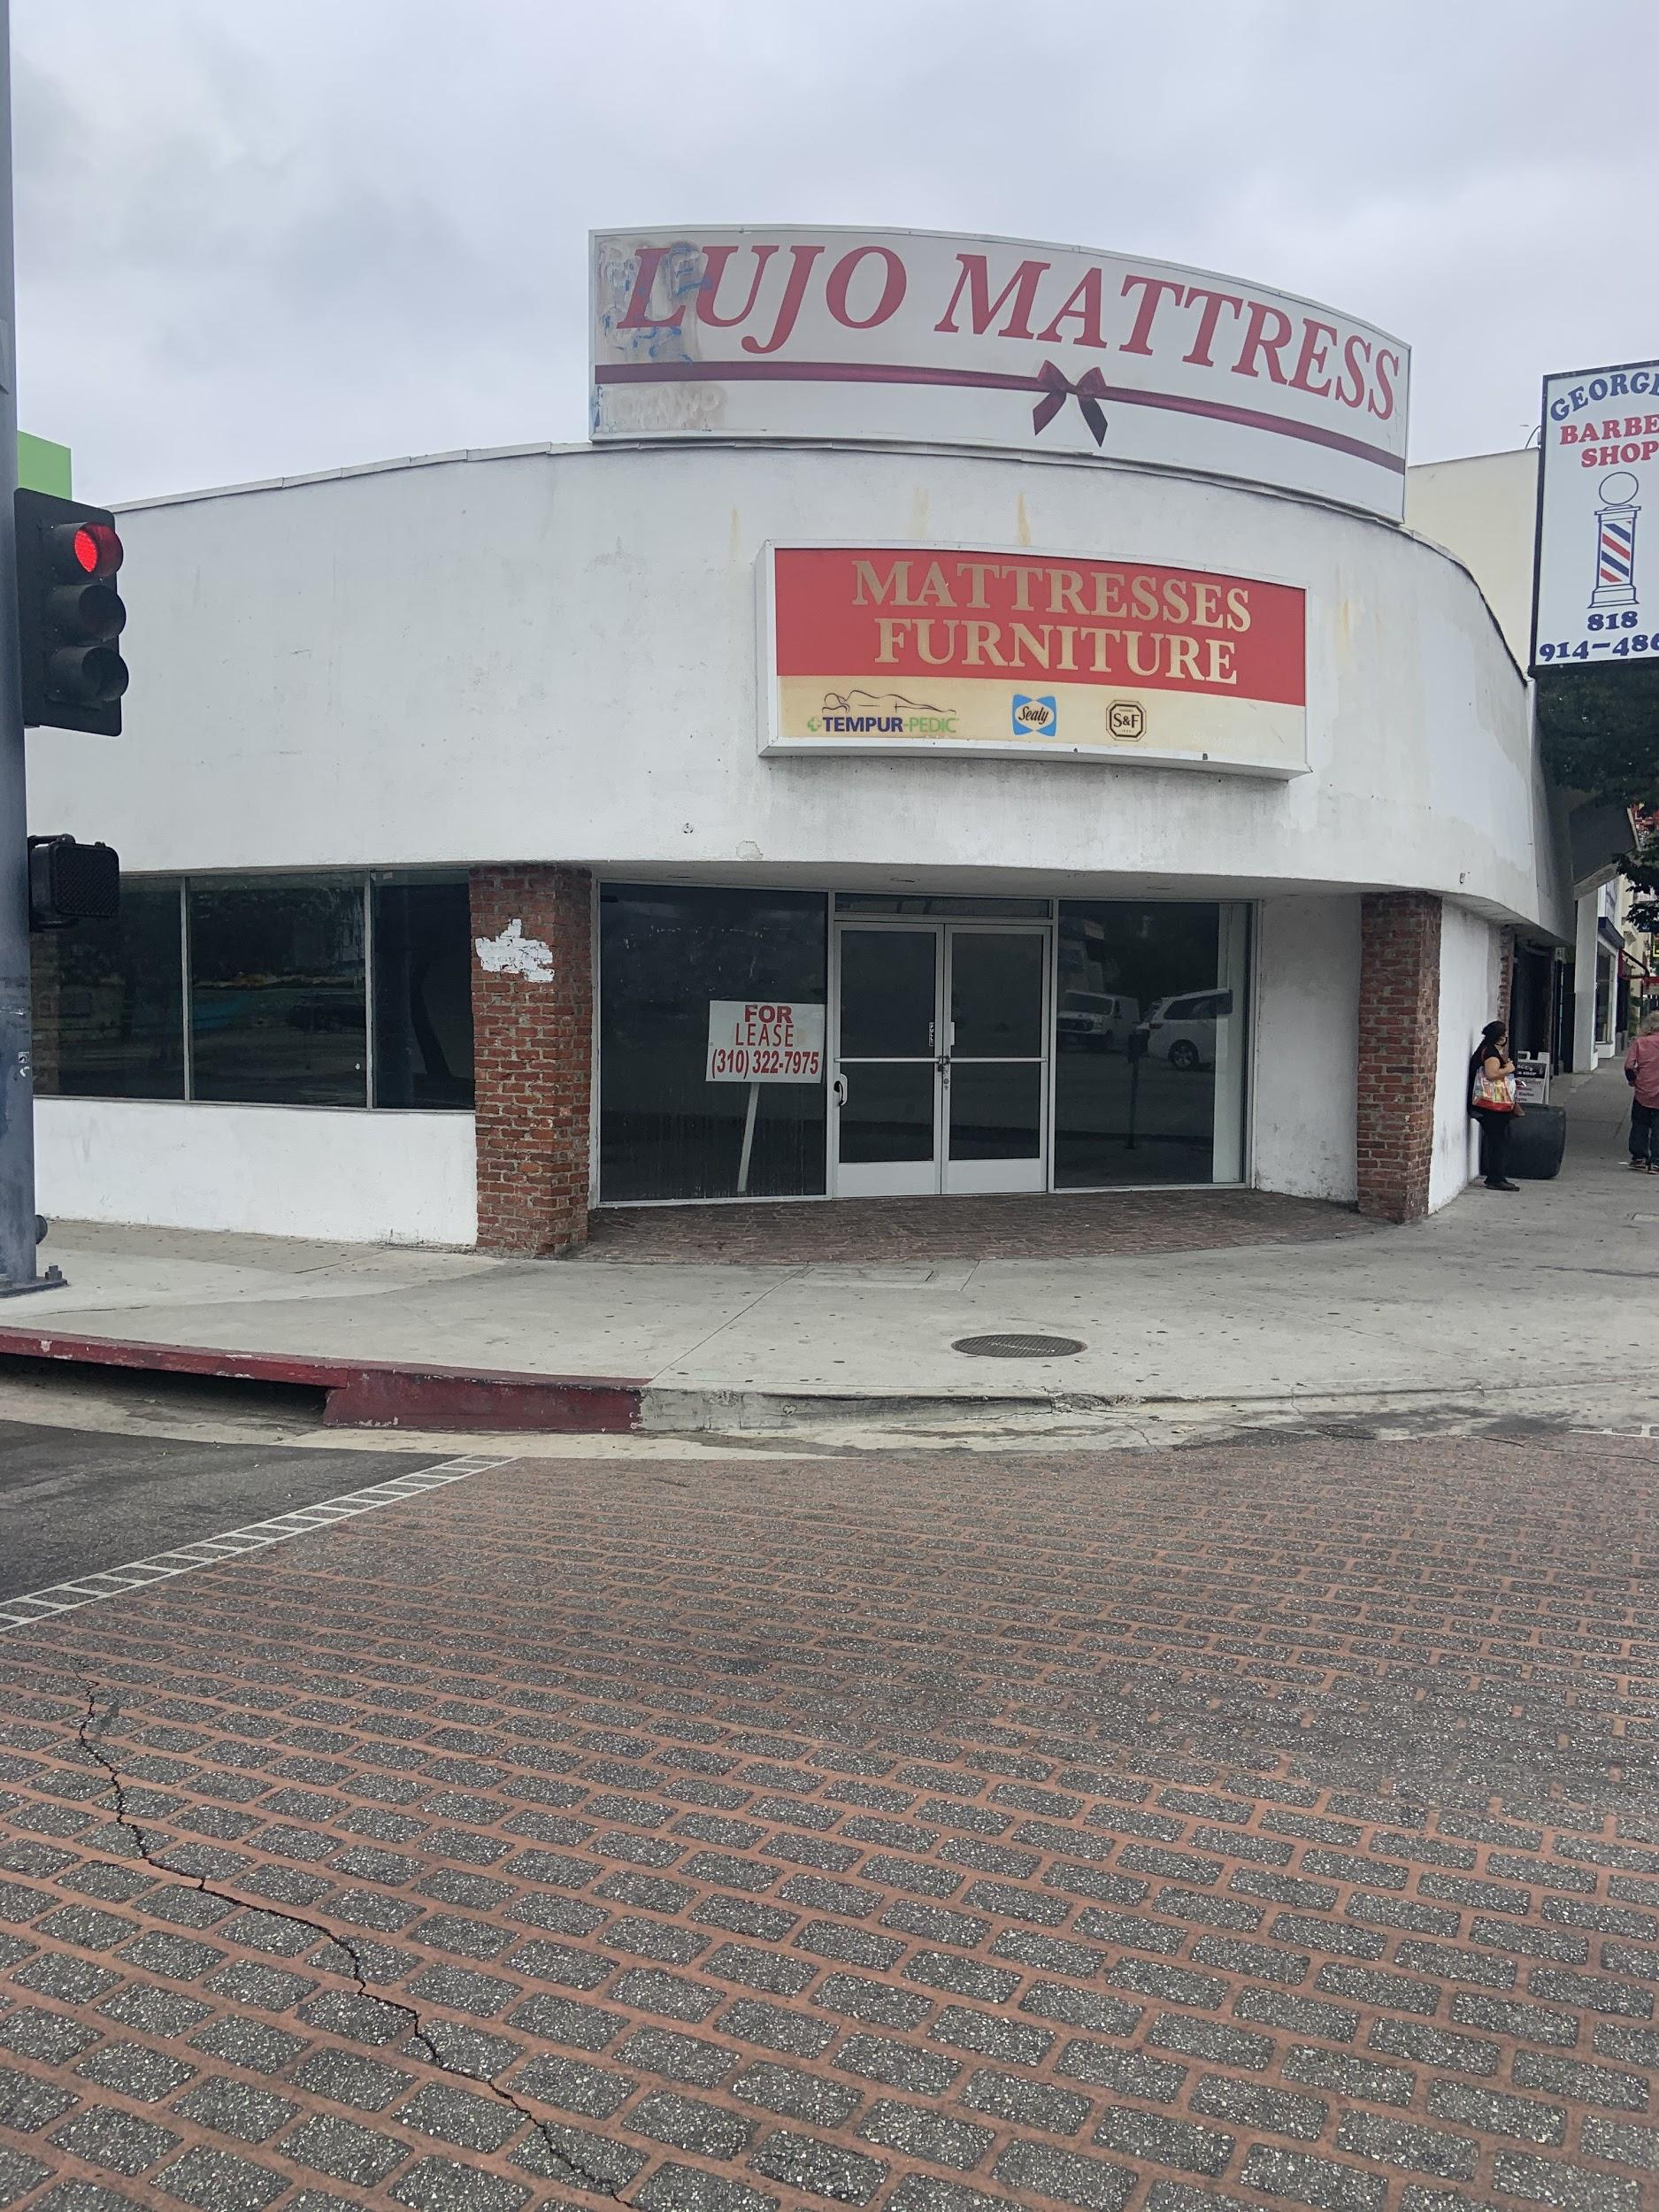
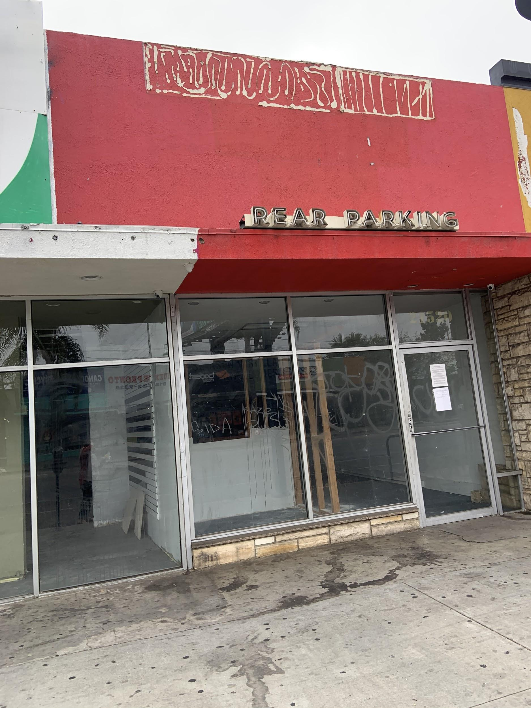
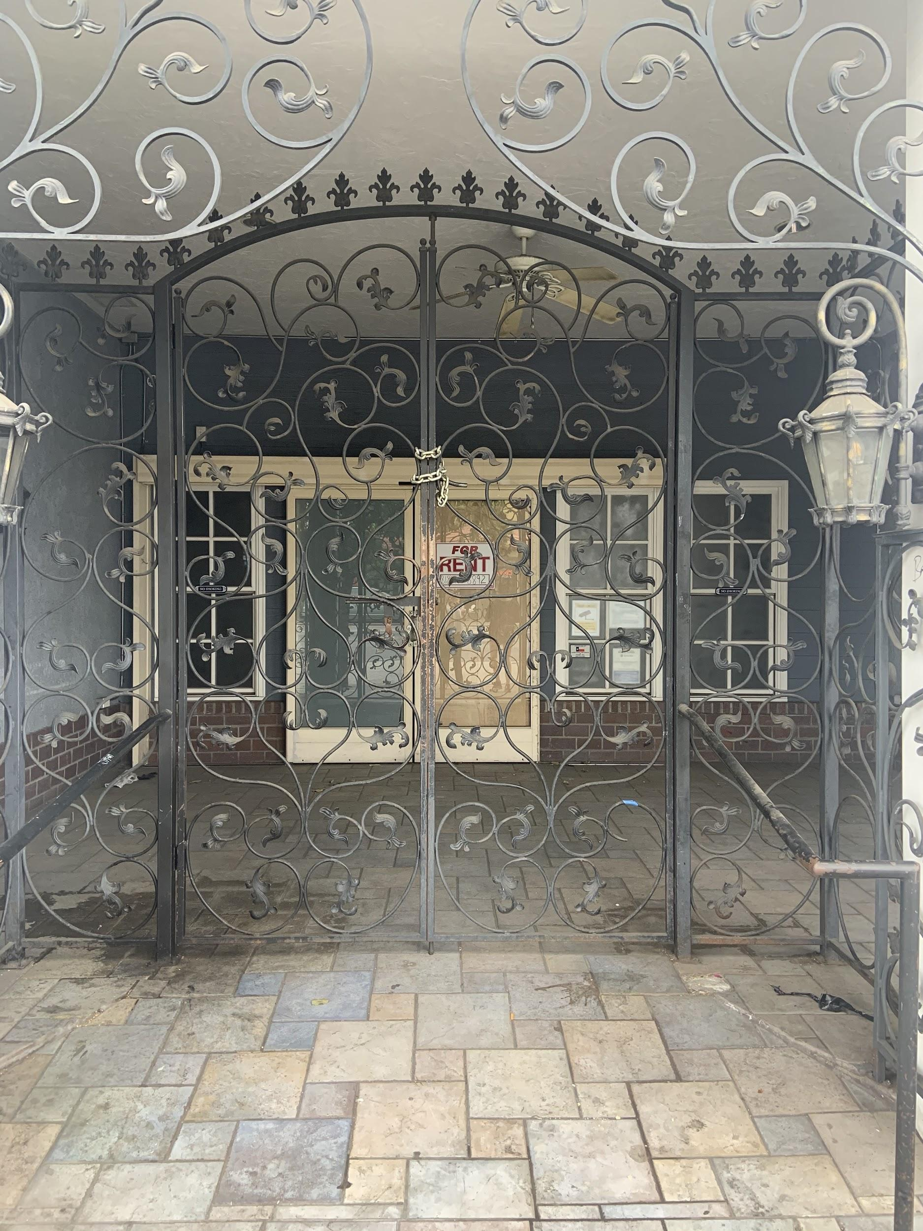
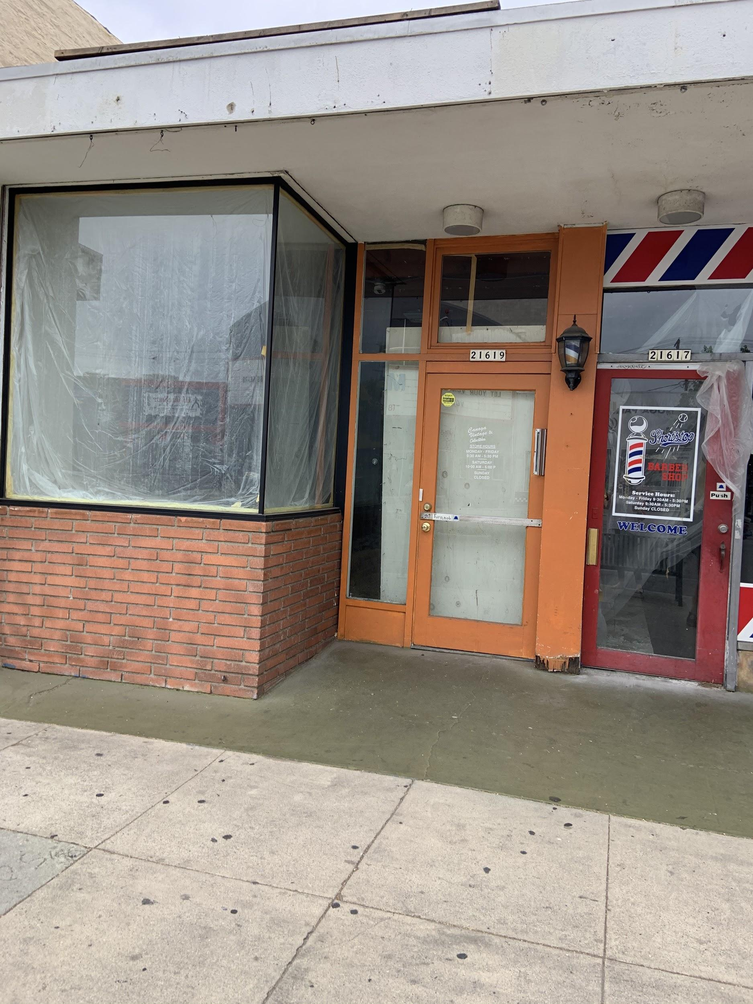
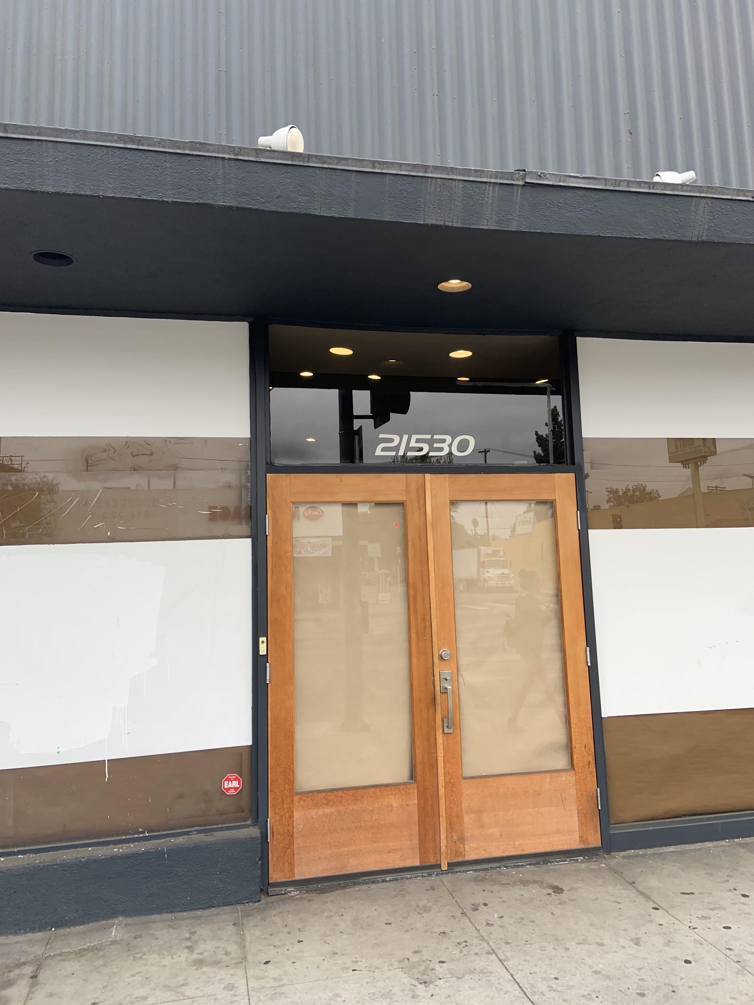
BID Business Closures
Business Vacancies

Slide 17
Canoga Park BID Loss of Revenue
Sales tax in Canoga Park is 9.5%
City of Los Angeles is entitled to 1% of that 9.5%.
Sample: 113 businesses
Estimate tax revenue generated is between $870,836 to $1,800,052.
Projected tax revenue loss from the remaining 36 businesses is between $75,000 to $181,500
City of Los Angeles would lose 10-12% of the tax revenue that would be typically generated by this strip because of COVID related closures.

Slide 18
Impact of Pandemic on Local Businesses
Some significantly hurt by pandemic & restrictions
India Sweets & Spices
Lost almost half of their revenue
Frontier Windows & Doors
Lost 35% of workforce
Others fairing well depending on business type
Essential businesses reopened faster
JB Bike Shop 2
Sales increased from increasing bike demand
Some switched business practices
Krystral Graphics Printing Shop: Brand Face Masks
Illustrates need for targeted support approach

Slide 19
Local Businesses Needs: Interview Themes
Many were too busy to communicate during business hours
Decreased foot traffic
Many businesses adjusted hours, protocols etc.
Difficult to note which businesses open online
Disinterest in taking on more debt when future earnings unsteady
Business owners: want another debt free stimulus package
Restaurant owners: want support for Al Fresco programs
City restrictions altered to expand outdoor dining areas
Ex: Parking lots & sidewalks
Desire increased promotion & marketing
Notes:
Although security and maintenance and beatification were also talked about in the interviews they seemed to be satisfied for that

Slide 20
Local Businesses Needs: Non-COVID Related
Tree trimming
Homeless population
Business owners using BID trash cans for personal business use
Trash piles quickly
Satisfaction with cleanliness & appreciation of BID security
Some desire increased security measures

Slide 21
4.
Action Options & Fiscal Impact
Notes:
Susie

Slide 22
Option 1: Enhanced Marketing Strategies
A. Monthly Pandemic E-Newsletter
Content includes:
Resources section (loans, grants, local initiatives)
Regulation changes & creative business solutions
Videos to share BID purpose & completed projects
Fiscal: None
B. Increase social media marketing campaigns
Facebook:
Promote business sales, websites, safety protocols
Yelp
Ensure business information up-to-date & positive reviews
Fiscal: Enhanced Marketing features
Facebook: $7.19 Per 1000 CPM
Yelp: $600.00 Per 1000 CPM

Slide 23
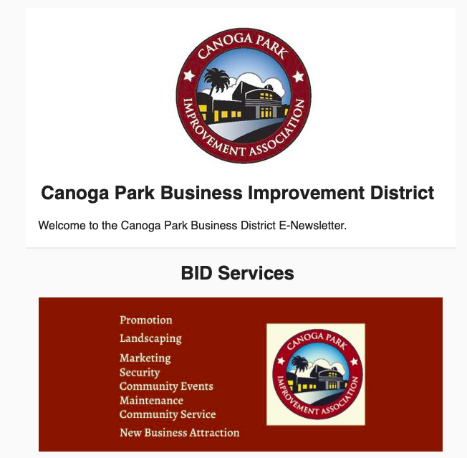
Marketing: Mailchimp Sample

Slide 24
Option 1: Enhanced Marketing Strategies
C. Website
Redesign to target public with digital directory & websites
Fiscal Impact:
If professional does website $2,000-5,000
None if use internal personnel

Slide 25
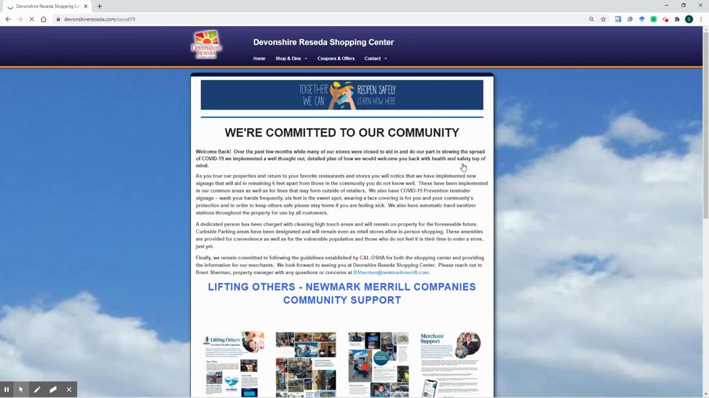
Website Redesign Example

Slide 26
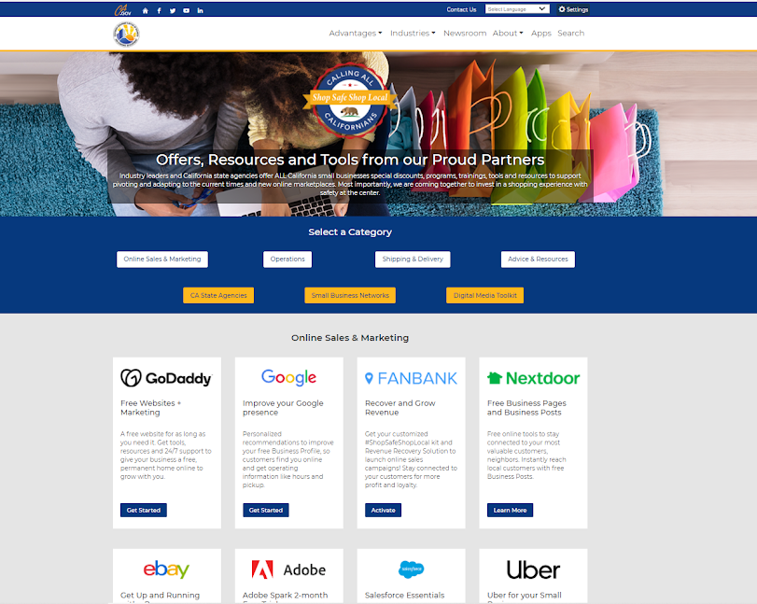
Option 2 : Small Business Improvement Strategies
Workshops
BID to provide resources themselves
Recommend community resources
Fiscal: None

Slide 27
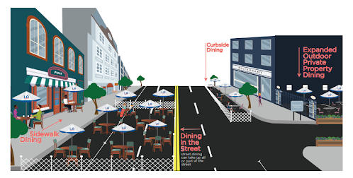
Option 2: Small Business Improvement Strategies
LA Al Fresco initiative
Difficult for public to know that restaurants are open
Provides visibility and additional business
Fiscal: none for BID

Slide 28
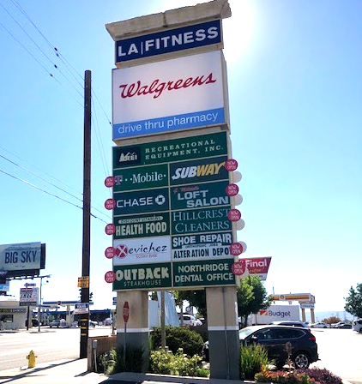
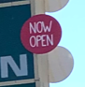
Option 2: Small Business Improvement Strategies
Physical Signage
Increasing signage to show businesses open.
change signage, now open stickers
partner with the graphic print shop in Canoga Park
Fiscal:$1,600-$2,000

Slide 29

Option 3: Maintain Status Quo
Continue current strategies without adding new ones
Businesses currently satisfied with security & beautification
Capacity for BID is lower b/c of COVID
Retain funding & personnel for future initiatives
Fiscal Impact: Potential continued loss of revenue

Slide 30
5.
Strategy for a Pathway Forward: Recommendations
Notes:
Chloe

Slide 31
Recommendation: Option 1 Hybrid
1. Adopt all marketing strategies
A. Pandemic E-newsletter (Mailchimp)
Add resources for Al Fresco Program
B. Enhance social media presence
Yelp & Facebook
C. Website
Pursue website update
See if can be financed this year from marketing budget of $34,000, if not add to budget for FY 2021-22
Reallocate from event funds
See if board member or CSU Northridge Computer Science or Marketing student groups can complete task
Investment opportunity

Slide 32
Benefits of Option 1
Why Choose Marketing?
Enhances communication between stakeholders
Primary desire of business owners
Supports all stakeholders
Customers: updated business information
BID: One of key strategies
Business owners: Can drive sales & foot-traffic
Property owners: Can enhance marketing for vacancies
Website future investment

